Slide 1
Detailed Project Report (DPR) Credit Card Default Prediction

Slide 2
Document Version Control
Date Issue | Version | Description | Author
07/03/2023 | 1 | Initial DPR - V 1.0 | Abdul Jaweed Lovely Patra
17/03/2023 | 2 | Initial DPR - V 2.0 | Abdul Jaweed Lovely Patra

Slide 3
Objective
The objective of the project is to build an end to end system which will be able to predict the credit cards defaulder.

Slide 4
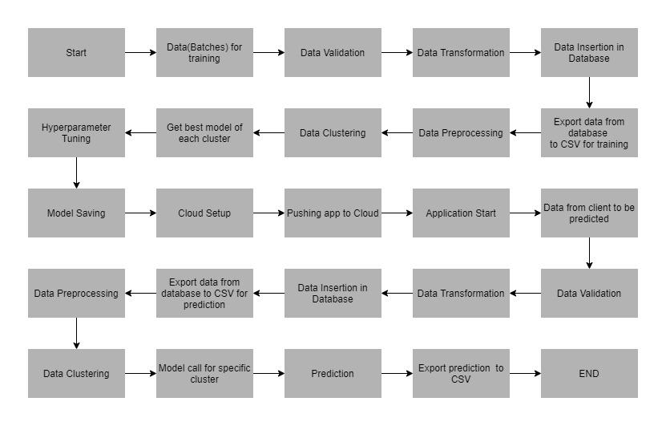
Architecture

Slide 5
About the Project
This dataset contains information on default payments, demographic factors, credit data, history of payment, and bill statements of credit card clients in Taiwan from April 2005 to September 2005.
The credit card default prediction dataset which is available in UCI Machine Learning Repository consists of 30000 rows and 25 columns.

Slide 6
Maintaining Logs
The logs are maintained in MongoDB. The logging starts with the start of application and for custom function which have created entry and exit logs are created to know about the time complexity of the function with respect to the operations, the function was supposed to do There are loggings for error scenarios and except block as well.

Slide 7
Data Pre-processing
To ensure that the data is given to us correct format, we have to sign a data sharing agreement with client to ensure that the right numbers of files are coming from their system, filename should be according the data sharing agreement column length etc. Based on this given from functional team, we will prepare the master management which is nothing but the schema training json file and schema prediction json file. This acts source of ground truth to us for our data validation process. Any file or data column which does not agree to master data management will be pushed to bad data folder in S3 buckets.
For the pre-processing, we used standard scaler and PCA transformation for dimensionality reduction. Replaced invalid values with nan values, encoded the target values, imputed the missing values, removed columns which had no meaning at all.

Slide 8
Roles and Responsibilities
My responsibilities included writing code to extract the data from S3 buckets, and perform data validation operations, data transformation operations and database operations in MongoDB for the first half of the project. Then I was involved in MLFlow integration and setup in cloud also in CI-CD operations with ECR and ECS deployment.

Slide 9
Deployment
Before the deployment was done, the entire application was containerised using Docker and deployed in AWS ECS and CI-CD integration tool being GitHub Actions.

Slide 10
Challenges faced during the Project
The biggest challenge is that getting good data for and building and robust model and would not take a lot of time to load and more accurate in the terms predictions and reduce more errors. Coming to code side, figuring out get the data S3 bucket without downloading the csv file from S3, and then keeping the entire pipeline run on cloud setup without local system interface, only thing will be in local is code developed. Even the trained models are saved to S3 buckets and loading of the model for prediction is also from the S3 bucket itself. Coming to AIOps part setting up MLFlow in cloud was challenging and as it involved creating Nginx configuration and Linux service management and attaching an elastic IP so that the endpoint url does not change whenever we restart the MLFlow application also ensure the security of the MLFlow server using Nginx and apache utils.

Slide 11
Q & A
Q1) What is the size of your data ?
The size of the data in terms of MB is 1, with with 30000 rows and 25 columns names are encrypted for security reasons
Q2) What are the data type ?
The columns consisted of both float and string values with missing values and some invalid values like “?”

Slide 12
Q & A
Q3) How are you monitoring your job ?
There are logging setup done. We can regularly monitor the logs to see for any error messages or scenarios.
Q4) What kind of the automation was done for data pre-processing ?
We had a full-fledged data pipeline which would extract the data from the S3 bucket, which had come from Big Data pipeline created by the client side.

Slide 13
Q & A
Q5) Where did you get the data ?
The data was provided by iNeuron.

